Slide 1
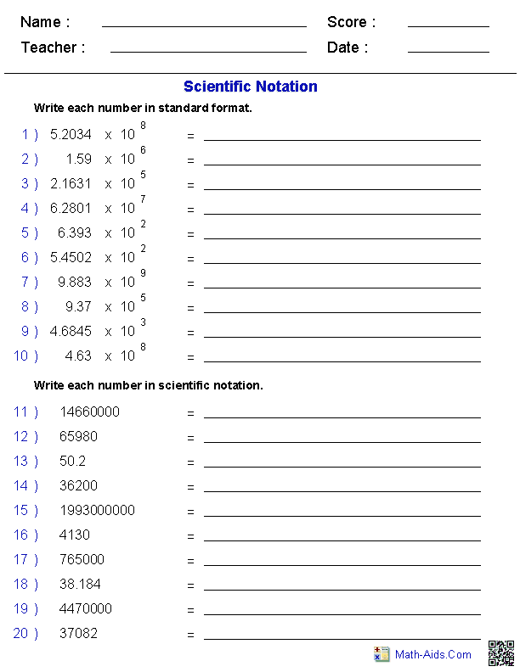

Slide 2
The odds of being struck by lightening during a year are about 1 in 700,000 which can be written as 7 x 10⁵
If you buy a 12 game OZ lotto ticket each week, your chances of winning during the year are 1 in 75,000 or 7.5 x 10⁴
You can find the chances of both happening by multiplying each chance together.
So how do we do that?

Slide 3
24
7
30
Topic : Scientific Notation
Date
EQ - How do we multiply and divide using scientific notation
Reorganise the problem so that the front numbers (co-efficients) are together.
7 x 10⁵ x 7.5 x 10⁴
7 x 7.5 x 10⁵ x 10⁴
2. Multiply the coefficients together.
52.5 x 10⁵ x 10⁴
3. Convert the new number to Scientific Notation
5.25 x 10¹ x 10⁵ x 10⁴
4. Use index laws to add the powers of the bases together
5.25 x 10¹⁰

Slide 4
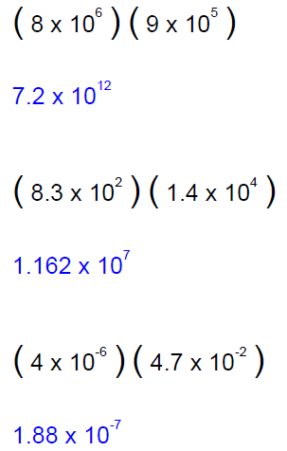
Let’s Try a few.

Slide 5
How about dividing with scientific notation?
The chance of winning OZ lotto for any single set of numbers is 1 in 45,000,000.
If you bought a 16 game ticket every week for 60 years, what are the odds you will win once during that time (that’s 49920 of numbers)?

Slide 6
24
7
30
Topic : Scientific Notation
Date
EQ - How do we multiply and divide using scientific notation
Reorganise the problem so that the front numbers (co-efficients) are divide together and the bases are divided together.
4.5 x 10⁷ ÷ 4.922 x 10⁴
4.5 ÷ 4.922 x 10⁷ ÷ 10⁴
2. Divide the coefficients by each other
0.914 x 10⁷ ÷ 10⁴
3. Convert the new number to Scientific Notation
9.14 x 10⁻¹ x 10⁷ ÷ 10⁴
4. Use index laws to add the powers of the bases together
9.14 x 10²

Slide 7
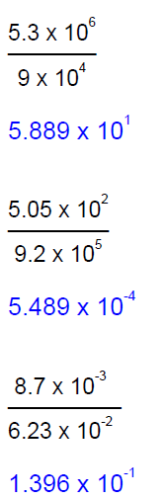
Let’s Try a few.

Slide 8
A 16 game oz lottoticket costs $21 so you would spend $65,520 to get a 1 in 910 chance of winning sometime over that 60 years.
Time to try the workss

